Slide 1
Lecture 9 Linked list Deletion and more
Prepared By:
Afsana Begum
Lecturer,
Software Engineering Department,
Daffodil International University.

Slide 2
Contents
Algorithm of Deletion
circular linked list and its advantage and examples
Linear linked list vs Circular Linked Lists
Array versus Linked Lists

Slide 3
Deletion from a Linked List
The next pointer field of node-A now points to node-B, where node-N previously pointed
The next pointer field of N now points to the original first node in the free pool, where AVAIL previously pointed.
AVAIL now points to the deleted node-N
START
Node A
Node N
Node B
(a) Before deletion of Node N
START
LINK[LOCP] = LINK [LOC]
After deletion
Node A
Node N
Node B
LOCP
LOC
AVAIL
LINK[LOC] = AVAIL and AVAIL = LOC
Free storage list

Slide 4
Finding a Node
FINDB(INFO, LINK, START, ITEM, LOC, LOCP)
This procedure finds the location LOC of the first node N which contains ITEM and the location LOCP of the node preceding node N.
If ITEM does not appear in the list, then sets LOC=NULL
If ITEM appear in the first node, then sets LOCP=NULL
[List Empty?] If START = NULL then:
Set LOC = NULL and LOCP = NULL and return.
[ITEM in the first node?] If INFO[START ] = ITEM, then:
Set START=LOC and LOCP = NULL and return.
PTR = START [initialize pointer]
Repeat step 5 , 6 and 7 while PTR ≠ NULL.
If INFO [PTR] = ITEM then:
Set LOC= NULL and LOCP = LINK[LOC] and Return.
PTR= LINK[LOC] [update pointer]
Else: Set LOC= NULL
Exit.
START
Node N
LOCP
LOC

Slide 5
Deleting a node
DELETE(INFO, LINK, START, AVAIL, ITEM)
Call FINDB(INFO, LINK, START, ITEM, LOC, LOCP)
IF LOC = NULL then: ITEM not in the list and exit.
Return deleted node to the AVAIL list
AVAIL = LINK[LOC] and INFO[LOC]=null
4. Exit.
Try to find the node with its value equal to ITEM

Slide 6
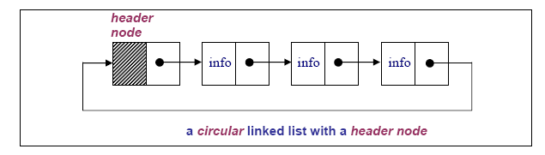
Variations of Linked Lists
Circular linked lists
The last node points to the first node of the list
How do we know when we have finished traversing the list? (Tip: check if the pointer of the current node is equal to the head.)

Slide 7
Variations of Linked Lists
circular linked list:
In a circular linked list there are two methods to know whether a node is the first node or not.
Either a external pointer, list, points the first node or
A header node is placed as the first node of the circular list.
The header node can be separated from the others by either heaving a sentinel value as the info part or
having a dedicated flag variable to specify if the node is a header node or not.

Slide 8
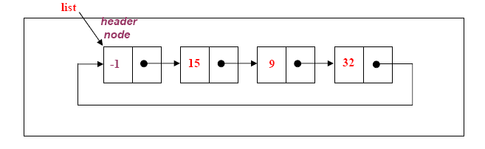
CIRCULAR LIST with header node
The header node in a circular list can be specified by a sentinel value or a dedicated flag:
Header Node with Sentinel: Assume that info part contains positive integers. Therefore the info part of a header node can be -1.

Slide 9
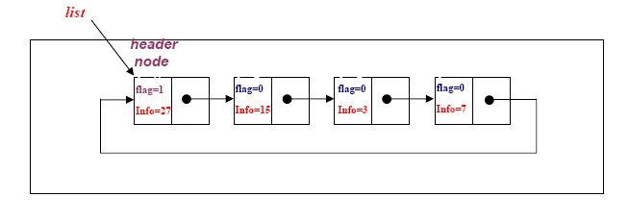
CIRCULAR LIST with header node
Header Node with Flag: In this case a extra variable called flag can be used to represent the header node.
For example flag in the header node can be 1, where the flag is 0 for the other nodes.

Slide 10
Example of application of circular linked list
A good example of an application where circular linked list should be used is a timesharing problem solved by the operating system.
In a timesharing environment, the operating system must maintain a list of present users and must alternately allow each user to use a small slice of CPU time, one user at a time.
The operating system will pick a user, let him/her use a small amount of CPU time and then move on to the next user, etc.
For this application, there should be no NIL pointers unless there is absolutely no one requesting CPU time.

Slide 11
Advantages
Each node is accessible from any node.
Certain operations, such as concatenation and splitting of string, is more efficient with circular linked list.
Disadvantage:
Danger of an infinite loop !

Slide 12
Linear linked list vs Circular Linked Lists
In linear linked lists if a list is traversed (all the elements visited) an external pointer to the list must be preserved in order to be able to reference the list again.
Circular linked lists can be used to help the traverse the same list again and again if needed. A circular list is very similar to the linear list where in the circular list the pointer of the last node points not NULL but the first node.

Slide 13
Array versus Linked Lists
Linked lists are more complex to code and manage than arrays, but they have some distinct advantages.
Dynamic: a linked list can easily grow and shrink in size.
We don’t need to know how many nodes will be in the list. They are created in memory as needed.
In contrast, the size of a C++ array is fixed at compilation time.
Easy and fast insertions and deletions
To insert or delete an element in an array, we need to copy to temporary variables to make room for new elements or close the gap caused by deleted elements.
With a linked list, no need to move other nodes. Only need to reset some pointers.

Slide 14
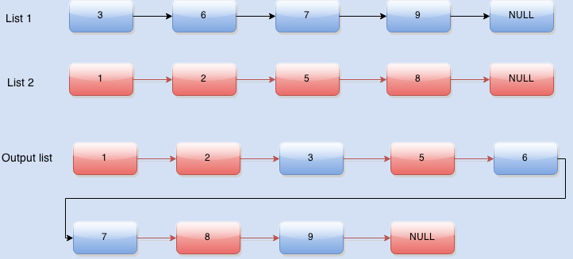
Link List Merge

Slide 15
Question?

